Slide 1


Slide 2


Welcome to Maui Community Toolkit
Gerald Versluis & Pedro Jesus

Slide 3
Welcome to Maui Community Toolkit
Gerald Versluis & Pedro Jesus

Slide 4

What Is the Xamarin/.NET MAUI Community Toolkit?
Project maintained by YOU!
Provides common building blocks for developers
For example: converters, behaviors, animations
Incubator for new controls/features
You might know the Windows Community Toolkit
Docs, monthly standup live stream, etc.
Notes:
Explain a bit about what the project is.

Slide 5

The Toolkits Today
Xamarin Community Toolkit (XCT)
Xamarin Community Toolkit Maui Compat
.NET MAUI Community Toolkit (MCT)
The XCT Maui Compat will have everything XCT has
The MCT will not have everything XCT has
MCT will work tightly with the Windows Community Toolkit (team)
Notes:
First a little bit about the different toolkits: history and background

Slide 6

Xamarin vs .NET MAUI Toolkit
XCT follows Xamarin.Forms timeline for deprecation
XCT Maui Compat will use .NET MAUI compatibility layer (using renderers)
MCT will follow .NET MAUI timeline for release
MCT is .NET MAUI native (using handlers)

Slide 7
Xamarin Community Toolkit (& Maui Compat)
Extensions
ImageResource
Translate
ValueConverter
Behaviors
Animations
Validators
EventToCommand
ImpliedOrderGrid
Masked (input)
UserStoppedTyping
Helpers
Localization
Subscription
WeakEvent
Converters
ByteArrayToImageSource
ItemSelectedEventArgs
MultiConverter
NotEqual
TextCase
MANY MORE!
ObjectModel
AsyncCommand
ObservableRangeCollection
Views
CameraView
Expander
SideMenuView
AvatarView
RangeSlider
Effects
SafeArea
github.com/xamarin/xamarincommunitytoolkit

Slide 8
.NET MAUI Community Toolkit (pre-release)
Behaviors
EventToCommandBehaivor
ImpliedOrderGridBehavior
MaskedBehavior
MaxLengthReachedBehavior
ProgressBarAnimationBehavior
UserStoppedTypingBehavior
Converters
BoolToObjectConverter
ByteArrayToImageSourceConverter
ColorToColorConverter
ColorToComponentConverter
ColorToStringConverter
CompareConverter
DateTimeOffsetConverter
DoubleToIntConverter
EnumToIntConverter
EqualConverter
ImageResourceConverter
IndexToArrayItemConverter
IntToBoolConverter
InvertedBoolConverter
IsNotNullOrEmptyConverter
IsNullOrEmptyConverter
ItemSelectedEventArgsConverter
ItemTappedEventArgsConverter
ListIsNullOrEmptyConverter
ListToStringConverter
MultiConverter
NotEqualConverter
StateToBooleanonverter
StringToListConverter
TextCaseConverter
TimeSpanToDoubleConverter
Extensions
ColorExtension
Views
StateLayout
github.com/CommunityToolkit/Maui

Slide 9
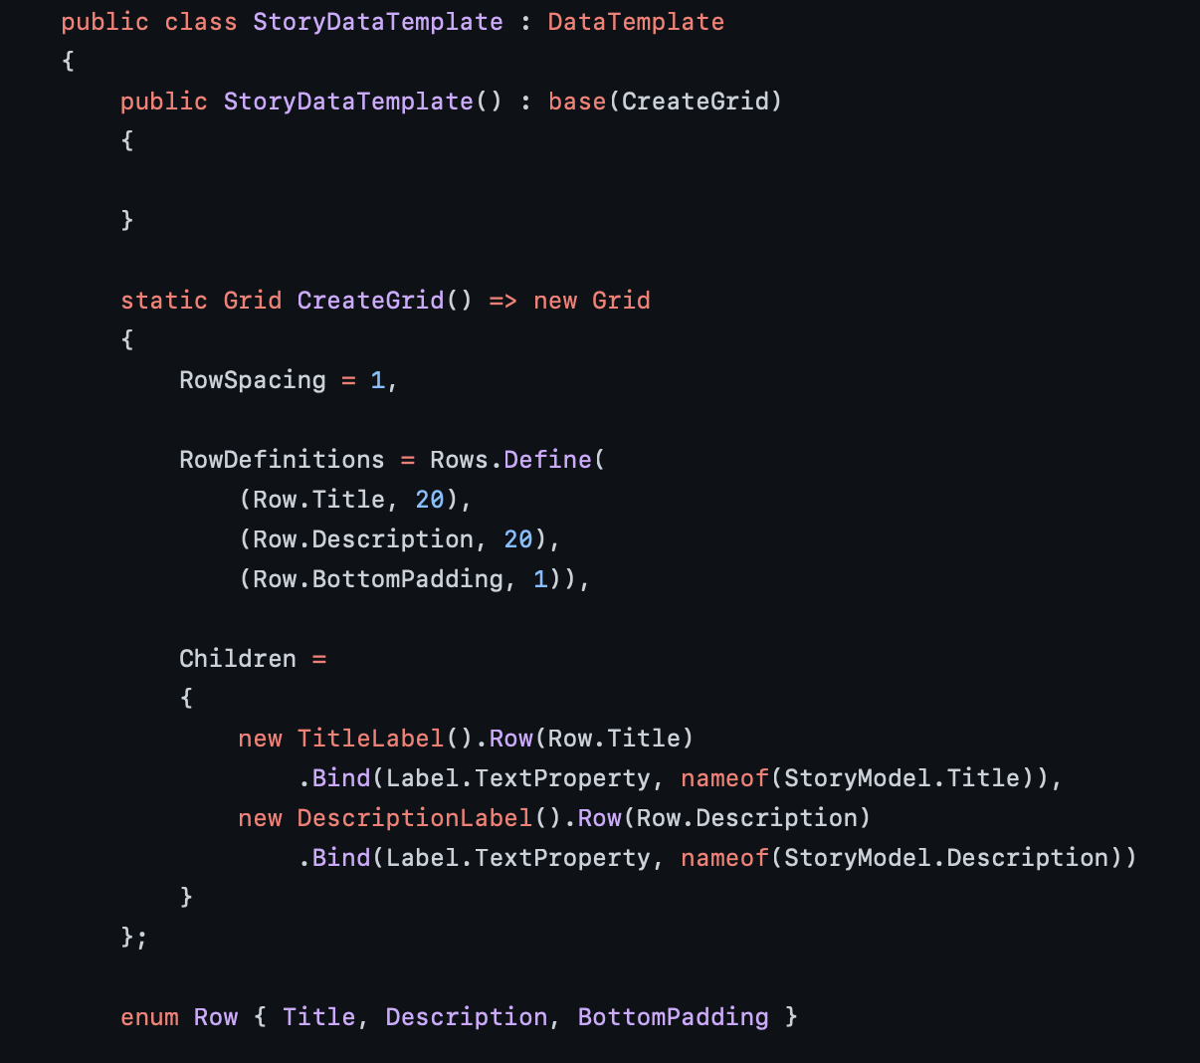
.NET MAUI Markup Community Toolkit (pre-release)
github.com/CommunityToolkit/Maui.Markup

Slide 10

Demo
Pedro Jesus

Slide 11
Get Involved!
Monthly Standup First Thursday of the Month
https://www.youtube.com/c/NETFoundation
.NET MAUI Community Toolkit Open for Contributions!
https://aka.ms/maui-toolkit
Note the champion workflow!

Slide 12
Code Sample
Code sample

Slide 13
Announcemnet
Value prop 1
Value prop 2
Value prop 3

Slide 14

Thanks for joining!
Gerald Versluis (@jfversluis // Gerald.Versluis@microsoft.com)
Pedro Jesus (@pj_souz)

Slide 15








Slide 16








Slide 17








Slide 18









Slide 19





Slide 20


Slide 21


Slide 22


Slide 23


